Slide 1

CENTRALIZED LOGGING USING ELK STACK Societe Generale
Internship Viva-Voice
Submitted To : Submitted By :
Ms. Sonal Shukla Aprajita Halder
Dr. Vikas Raina B.Tech CSE-CC (C2)
4th year – 170396

Slide 2
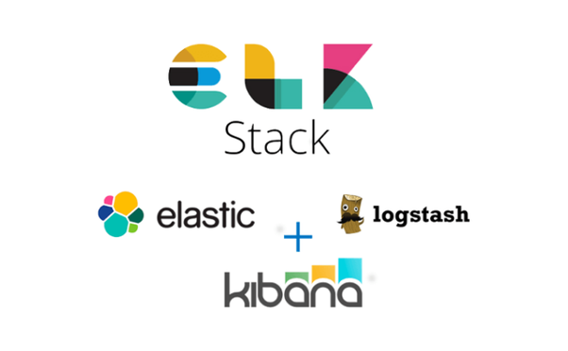

Slide 3
ABSTRACT
This is a spring boot project, which generates a log file of the application. We gave the logfile to logstash. The data is documented to elasticseach. Elasticsearch is a NoSQL database, used for storing unstructured data. It is based on apache lucene. The data is stored in JSON format. Then data from elasticsearch will be send to kibana to visualize index patterns. The project consists of single microserver. ELK stack can be storing and processing huge logs, generated by multiple microservers. We will need a spring boot starter web dependencies.

Slide 4
Log Analysis
In cloud-based environment infrastructures, performance, and isolation is very important. The, reliability and node failure can become a significant issue.
Log management platform can monitor all above-given issues as well as process operating system logs, server log for web traffic analysis, application logs, and logs on AWS (Amazon web services).
Log management helps DevOps engineers, system admin to make better business decisions. Hence, log analysis via Elastic Stack or similar tools is important.

Slide 5
What is Spring Boot
Spring Boot is a project that is built on the top of the Spring Framework. It provides an easier and faster way to set up, configure, and run both simple and web-based applications.
It is a Spring module that provides the RAD (Rapid Application Development) feature to the Spring Framework. It is used to create a stand-alone Spring-based application that you can just run because it needs minimal Spring configuration.

Slide 6
Why Spring Boot
The dependency injection approach is used in Spring Boot.
It contains powerful database transaction management capabilities.
It simplifies integration with other Java frameworks like JPA/Hibernate ORM, Struts, etc.
It reduces the cost and development time of the application.

Slide 7
Advantages of Spring Boot
It creates stand-alone Spring applications that can be started using Java -jar.
It tests web applications easily with the help of different Embedded HTTP servers such as Tomcat, Jetty, etc. We don't need to deploy WAR files.
It provides opinionated 'starter' POMs to simplify our Maven configuration.

Slide 8
Advantages of Spring Boot
It provides production-ready features
There is no requirement for XML configuration.
It offers a CLI tool for developing and testing
It offers the number of plug-ins.
It also minimizes writing multiple boilerplate codes, XML configuration, and annotations.
It increases productivity and reduces development time.

Slide 9
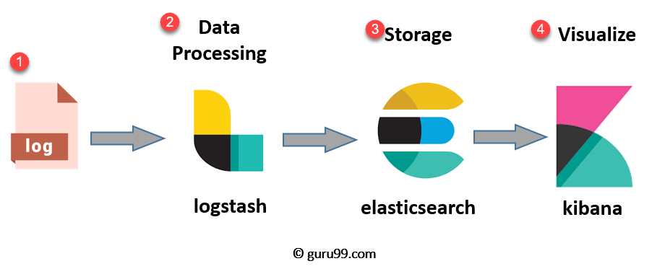
ELK Stack

Slide 10
The ELK Stack is a collection of three open-source products — Elasticsearch, Logstash, and Kibana. ELK stack provides centralized logging in order to identify problems with servers or applications.

Slide 11


Slide 12
What is Elasticsearch?
Elasticsearch is a NoSQL database. It is based on Lucene search engine, and it is built with RESTful APIS.
Elasticsearch also allows you to store, search and analyze big volume of data.
It has been adopted in search engine platforms for modern web and mobile applications. Apart from a quick search, the tool also offers complex analytics and many advanced features.

Slide 13
Features of Elastic search:
Open source search server is written using Java
Used to index any kind of heterogeneous data
Has REST API web-interface with JSON output
Full-Text Search
Near Real Time (NRT) search
Sharded, replicated searchable, JSON document store
Schema-free, REST & JSON based distributed document store
Multi-language & Geolocation support

Slide 14
Advantages of Elasticsearch
Store schema-less data and also creates a schema for your data
Manipulate your data record by record with the help of Multi-document APIs
Perform filtering and querying your data for insights
Based on Apache Lucene and provides RESTful API
Provides horizontal scalability, reliability, and multitenant capability for real time use of indexing to make it faster search
Helps you to scale vertically and horizontally

Slide 15
Elasticsearch Queries
Boolean Operators
Elasticsearch supports the AND, OR, and NOT operators:
Eg. jack AND jill — Will return events that contain both jack and jill
Fields
While looking for events where a specific field contains certain terms. We can specify as follows:
Eg. name: ”Ned Stark”
Ranges
We can also search for fields within a specific range, using square brackets for inclusive range searches and curly braces for exclusive range searches:
Eg. age:[3 TO 10] — Will return events with age between 3 and 10

Slide 16
URI Search
pass a simple query to Elasticsearch using the q query parameter
Eg. curl “localhost:9200/_search?q=name:travis”
curl “localhost:9200/_search?q=name:john~1 AND (age:[30 TO 40} OR surname:K*) AND -city”
REST API Request:
GET _search{
“query” : {
“match-all” : {}
}
}

Slide 17
LOGSTASH EXAMPLE
Import csv file
input{
file{
path=> “…….csv”
start_position => “beginning”
sincedb_path => “NULL” %keeps track of where it was last reading a file before crash
}
}

Slide 18
LOGSTASH EXAMPLE
filter{
csv{
separator => “ , ”
columns => [ , ]
}
}

Slide 19
LOGSTASH EXAMPLE
Output{
elasticsearch{
hosts =>” http://localhost:9200”
index => “ with all small letters”
}
stdout {}
}

Slide 20


Slide 21
What is Logstash?
Logstash is the data collection pipeline tool. It collects data inputs and feeds into the Elasticsearch. It gathers all types of data from the different source and makes it available for further use.
Logstash can unify data from disparate sources and normalize the data into your desired destinations. It allows you to cleanse and democratize all your data for analytics and visualization of use cases.

Slide 22
It consists of three components:
Input: passing logs to process them into machine understandable format
Filters: It is a set of conditions to perform a particular action or event
Output: Decision maker for processed event or log

Slide 23
Features of Logstash
Events are passed through each phase using internal queues
Allows different inputs for your logs
Filtering/parsing for your logs

Slide 24
Advantage of Logstash
Offers centralize the data processing
It analyzes a large variety of structured/unstructured data and events
ELK LogStash offers plugins to connect with various types of input sources and platforms

Slide 25


Slide 26
What is Kibana?
Kibana is a data visualization which completes the ELK stack. This tool is used for visualizing the Elasticsearch documents and helps developers to have a quick insight into it. Kibana dashboard offers various interactive diagrams, geospatial data, and graphs to visualize complex quires.
It can be used for search, view, and interact with data stored in Elasticsearch directories. Kibana helps you to perform advanced data analysis and visualize your data in a variety of tables, charts, and maps.
In Kibana there are different methods for performing searches on your data.

Slide 27
Features of Kibana:
Powerful front-end dashboard which is capable of visualizing indexed information from the elastic cluster
Enables real-time search of indexed information
You can search, View, and interact with data stored in Elasticsearch
Execute queries on data & visualize results in charts, tables, and maps
Configurable dashboard to slice and dice logstash logs in elasticsearch
Capable of providing historical data in the form of graphs, charts, etc.
Real-time dashboards which is easily configurable
Kibana ElasticSearch enables real-time search of indexed information

Slide 28
Advantages and Disadvantage
Easy visualizing
Fully integrated with Elasticsearch
Visualization tool
Offers real-time analysis, charting, summarization, and debugging capabilities
Provides instinctive and user-friendly interface
Allows sharing of snapshots of the logs searched through
Permits saving the dashboard and managing multiple dashboards

Slide 29
Search Types in Kibana
In Kibana there are different methods for performing searches on the data.
The most common search types are:
Search Type | Usage
Free text searches | It is used for searching a specific string
Field-level searches | It is used for searching for a string within a specific field
Logical statements | It is used to combine searches into a logical statement.
Proximity searches | It is used for searching terms within specific character proximity.

Slide 30
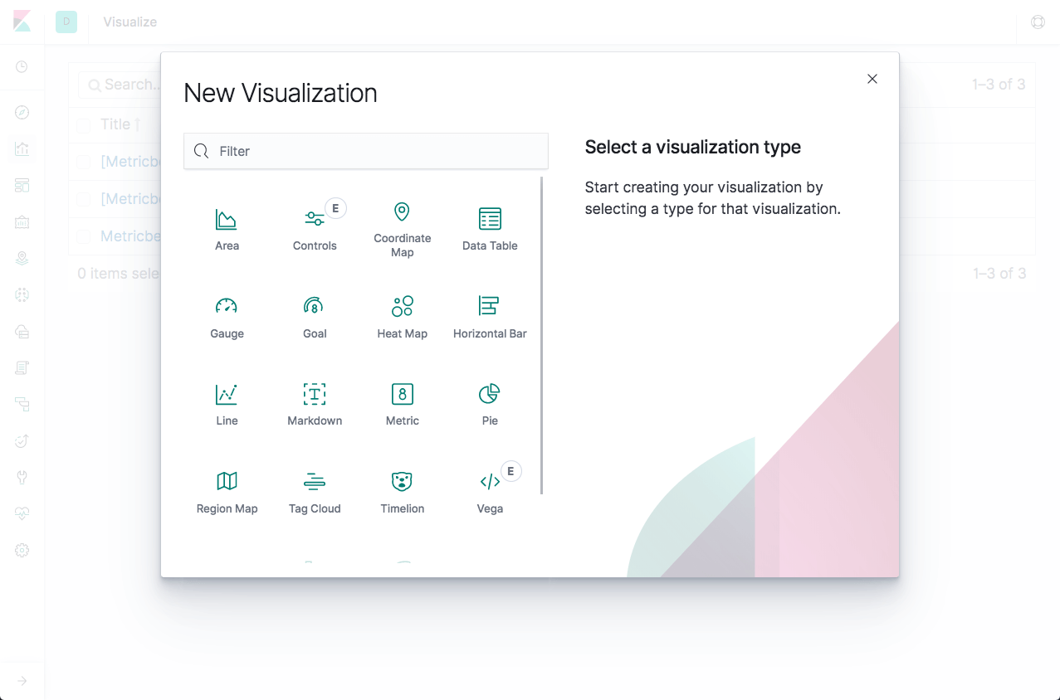
Kibana visualizations
Five different types of visualizations:
Basic Charts
Data
Maps
Time series
Other

Slide 31
Kibana Elasticsearch index
The searches, visualizations, and dashboards saved in Kibana are called objects. These objects are stored in a dedicated Elasticsearch index (.kibana) for debugging, sharing, repeated usage and backup.
The index is created as soon as Kibana starts. It’s name can be changed in the Kibana configuration file. The index contains the following documents, each containing their own set of fields:
Saved index patterns
Saved searches
Saved visualizations
Saved dashboards

Slide 32
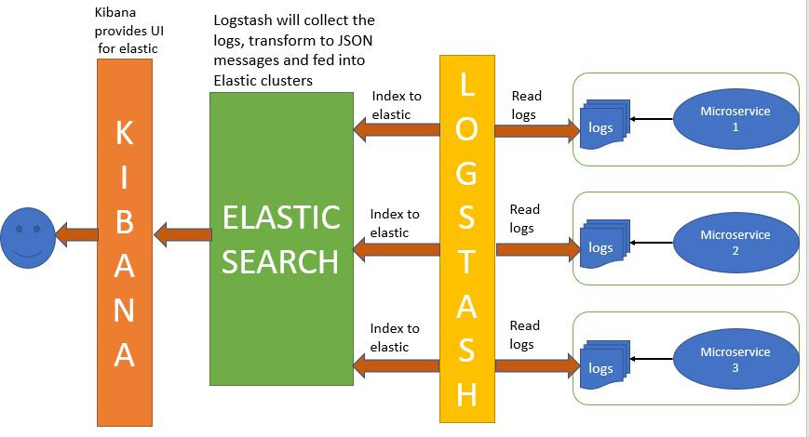
DATA FLOW

Slide 33
Future Enhancement
Current system is based on one microserver. In future, we may add multiple microserver, which will generate enormous amount of logs.
We will add more advanced features and complex task in our user class.
In logstash, we will process the data in-depth for patterns, by adding filters.
Deployment will be done of a production-ready application with enhanced testing and verification process.

Slide 34


